Slide 1


Smart parking
Welcome

Slide 2

Project idea
When a person is in a hurry and is looking for the nearest place to park his car, he can use an application linked to underground sensors.

Slide 3
Business need
Many workers can be employed to guard the premises.
The role of the workers is to guard the garage and cars.
Each garage will have a manager to organize workers.
The project will target 100 workers and 50 managers.

Slide 4
The project charter
Project name: | Smart Parking system | Project Manager: |  | Mohand hatem
Project sponsor: | sensor applications Google maps | Date of project approval: |  | Jan–March 2021..
Last revision date: | 1-march-2022 | Project Description: |  | When a person is in hurry and is looking for the nearest place to park his car, he can use this application linked to underground sensor.
THE SCOPE : | Our Parking Management System will ease people's task of finding safe parking spots in real time. The system helps an individual to pre-book the parking spot from the distant area, reducing traffic congestion and allowing a user to know the availability of parking space in advance.
Constraints: | Time |  | four months
 | Budget |  | 100 Software engineers , 50 managers
 | Scope
 | Quality |  | Efficiency , faster process than the normal, Provides information of the available places , Increased service
Project Deliverables: | Deliverables in the early design phase of a project might be a list of specifications. In the second phase deliverables could be software coding and a technical manual. The next phase could be the prototype. The final phase could be final tests and approved software
Project Team: | 1-5 developers 2-one manager
Benefits: | Our parking management solution can significantly offer benefit to both the user and the parking lot owner as it: 1-helps in reducing traffic by enhancing user experience. 2-This system supports various parking applications that can easily handle and organize the data of vehicles. 3-To rectify the complications of parking security, our parking management system allows to recognize and validate the automobiles at both entry and exit points.
RISKS: | 1- It is possible for databases to lose their connection with the program. 2-Sensor failure may occur. 3-It is possible to spy on the customer’s information and find out his car number or his whereabouts.

Slide 5
The budget
The budget for sensor applications only is 269,567 $.
The project need 100 software engineer.
Every software engineer’s budget is 7,000 $ monthly.
Launching the application will require ads at a cost of $10,000

Slide 6

Resources of the project
-sensor applications
-Google maps

Slide 7
The budget and the time that we need to develop the project:
The budget : The global parking management market was valued at USD 3,682.1 million in 2019, and it is projected to be worth USD 5,762.8 million by 2025, registering a CAGR of 10.3% during the period 2020-2025.
How many developers will work in the project?
6 developers will work in this project then we will need for 6 laptops one for each developer , and we will need a server for the project update and download like Digital Ocean or Amazon.
we will need two months or three at least but the time will be increased if there are more updates in the project , why we need for three months : because the project will be 10 or 12 pages because it will contain a lot of options like page for the login , one for sign up , on for the map and one for the information of the car ……etc

Slide 8

The scope
project objective :
The goal of the project is to facilitate the idea of parking the car for the customer by placing a sensor underground to park the car easily and without effort and time

Slide 9
Project Scope: Deliverables
Deliverables in the early design phase of a project might be a list of specifications. In the second phase deliverables could be software coding and a technical manual. The next phase could be the prototype. The final phase could be final tests and approved software

Slide 10
The scope:
Time scope:
Study was conducted for duration of four months from Jan–March 2021 from the stage of analysis , data collection and system development , for the purpose of collecting righteous information to enable me develop the system.
The initial cost:
the initial cost of setting up the system will include the cost of hardware software (OS, add-on software , utilities)&labor(setup & maintenance).the same has to bear by the organization

Slide 11
The scope:
Technical requirements
*Hardware requirements*
1 – Sensors 2 – Mobile phones 3 – Car barriers *Software requirements* 1 – Java and flutter to develop the application 2 – Google maps 3-Gps Customer reviews This app made me over-time and made it easier for me to have a parking space.

Slide 12
Project Scope LIMITS & EXCLUSIONS
Work on site is allowed only between the hours of 9:00 am - 4:00 pm; System maintenance and repair will be done only up to one month after final inspection; Client will be billed for additional training beyond that prescribed in the contract. - Data will be collected by the client, not the contractor; a house will be built, but no landscaping or security devices added; software will be installed, but no training given.

Slide 13
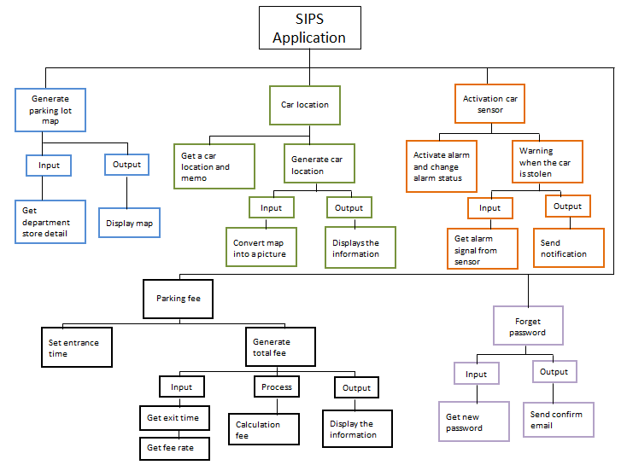
WBS

Slide 14
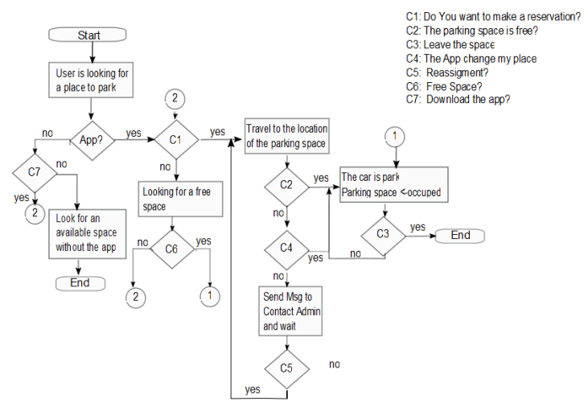
Flow diagrams that represent the user/driver process.

Slide 15
Risks
1- It is possible for databases to lose their connection with the program, Solution:
so, programmers (back-end developers) must be available to solve this problem
2-Sensor failure may occur
Solution:
embedded software engineer can detect the existing malfunction and fix it
3-It is possible to spy on the customer’s information and find out his car number or his whereabouts
Solution:
This issue is already being reviewed by IT engineers

Slide 16
The project information for the parking system is presented here :
ID | DESCRIPTION | Predecessor | Time
A | Requirement Gathering | None | 4
B | Analysis | A | 4
C | Design | A | 5
D | Coding | B | 7
E | testing | C,B | 3
F | Implemented | D,E | 1

Slide 17
Network Project:
4 | B | 8
6 |  | 2
4 | 4 | 8
8 | D | 15
8 |  | 1
8 | 7 | 15
0 | A | 4
0 |  | 2
0 | 4 | 4
15 | F | 16
0 |  | 1
15 | 1 | 16
9 | E | 12
0 |  | 1
12 | 3 | 15
4 | C | 9
0 |  | 2
7 | 5 | 12
ES |  | EF
SL
LS | DU | LF

Slide 18
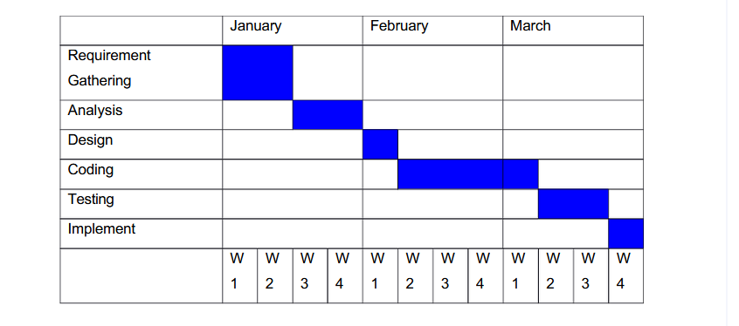
Gantt chart:

Slide 19
Resource Allocation
ID | Res | Dur
A | 2 | 10 | 2 | 2 | 2 | 2
B | 2 | 5 |  |  |  | 2 | 2 | 2 | 2
C | 2 | 25 |  |  |  | 2 | 2 | 2 | 2 | 2
D | 1 | 25 |  |  |  |  |  |  |  | 1 | 1 | 1 | 1 | 1 | 1 | 1
E | 1 | 15 |  |  |  |  |  |  |  |  |  | 1 | 1 | 1
F | 1 | 35 |  |  |  |  |  |  |  |  |  |  |  |  |  |  | 1
RES shuddle |  |  | 2 | 2 | 2 | 6 | 4 | 4 | 4 | 3 | 1 | 2 | 2 | 2 | 1 | 1 | 1
Resoucer Profile |  |  | 6 | 6 | 6 | 6 | 6 | 6 | 6 | 6 | 6 | 6 | 6 | 6 | 6 | 6 | 6

Slide 20
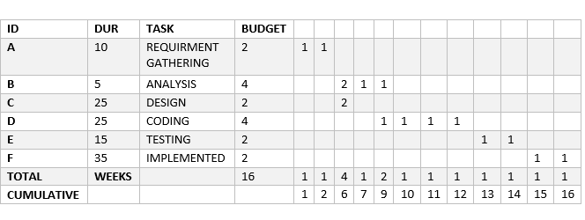
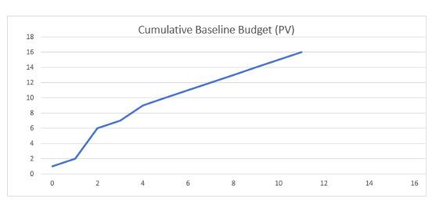
The total budget in units of time
Budget Baseline:
Cumulative Baseline budget:

Slide 21
The sponsor
-Sponsor of our project is “Senko company , Google”.
-It is a leading company in the sensor industry.

Slide 22
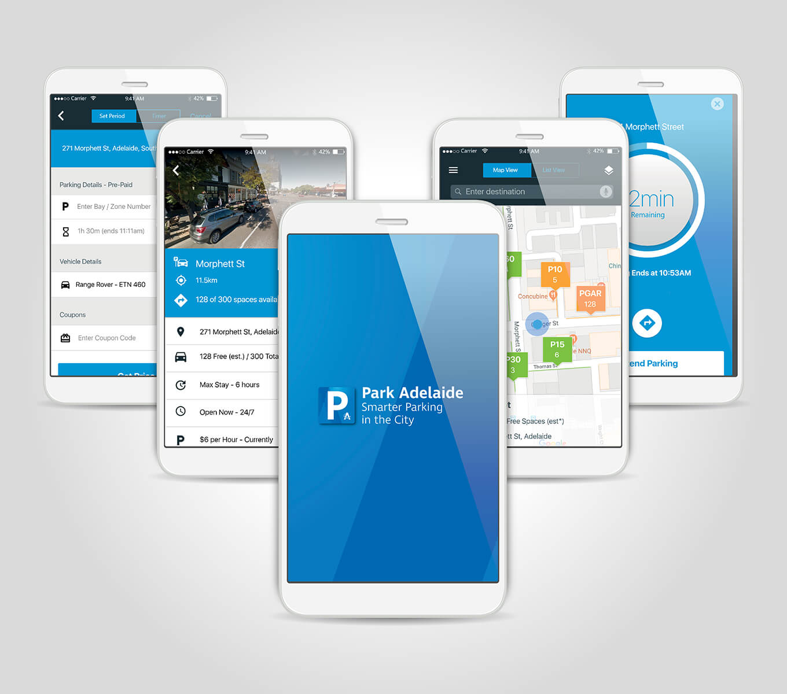
Photos of Application:

Slide 23
Then here are some of the advantages that you are sure to enjoy: -
Efficiency :The parking management system doesn’t rely on a man to do the job; instead, it deals with software and smartphones, which are less likely to make mistakes. The man at the gate deals with a lot of people at once; he can get tired and even can become ill or absent from work. On the other hand, automated software always works as long as you have your phone on, which is quite often. You get to decide how you want to pay or what you want to do precisely. As a result, the level of efficiency increases, and you get to deal with parking protocols without issues.
Faster processes : Having to stand at the gate and wait for the human guard to finish dealing with one person before going ahead can be daunting and time-wasting? So what if you could handle your parking protocols yourself and be the determinant of when you enter the building without delay? One of the advantages of a parking management system is that you can do this very quickly. Employees can avoid the long queue at the gate every morning and go right ahead to enter the building or make use of the parking space on their own

Slide 24
Then here are some of the advantages that you are sure to enjoy: -
Provides information: When the man at the gate is busy, who do you ask questions on the parking protocols? Or in the case of the hardware system, do you talk to the machines? For the modern parking management system, which makes use of software, you can ask various questions through your phone. Questions on spaces, occupancy, overstay, or illegal parking? They can all be answered from wherever you are.
Reports : The modern software-oriented type of parking management system also involves reporting. Not only does it make things easier for users, but managers also enjoy a fair share of having workload reduced for them when it comes to monitoring and managing parking spaces. They receive reports on the vehicles in the building, as well as the time of access. The need for paper and pencil way of recording is no longer necessary, and things are automated. There’s even the option of one-on-one counting of vehicles.
Increased Service A company with parking lot management software can serve its customers, clients, and workers better. This is because they can reduce the magnitude of stress that comes into parking. Visitors no longer have to worry about driving around to look for space. They get to save petrol and even reduce pollution as there is provision for a place to drive into once the vehicles enter into the buildings.

Slide 25
Advantages of a Parking Management System:
Using Parking management software is one of the best decisions that an organization can make. This is because of the many benefits that come with it. Not only does it take out inefficiency on the part of the human worker, but it also helps to improve the user’s experience when it comes to parking and utilizes the parking space available for parking. You don’t know what a parking system is? A parking management system is a product, or a kind of software specially designed for the parking industry. It focuses on helping individuals manage their parking procedures. For this purpose, it has automated gates that control entry, ticketing system which has autonomy, and several other features or add on. It has been created to tackle the dysfunctional system that comes with the traditional parking style. Without working on space and solely with the software, the parking capacity of companies can improve tremendously too. In order to perform its function adequately, it’s made up of various components that work together to give the best results. Some of the components are Maps, automated ticketing, statistical report features, surveillance, linked recognition, and security analysis. All of these features are important as they help the software to function well and adequately. Parking Management System Are you considering adopting the parking management system?

Slide 26
Some of the Disadvantages
Making use of the parking management system has a lot of advantages for many of the parties involved. But then, it comes with some disadvantages. These disadvantages are reasons why some people have had second thoughts about making use of the parking management system. Nonetheless, these disadvantages are not ones that cannot be handled at any time.
1. The high cost of construction or installation The cost of having a sound, working parking management system is usually high. This is because of the various components that go into making the system work. Components such as the statistical feature, automated ticketing, and statistical reports, and many others make it all expensive. Some organizations may not be able to afford such.
2. Regular maintenance The system is automated; however, it still requires several regular maintenances from the company. This is to ensure that the system is working perfectly and that nothing has gone wrong. The maintenance could be once in months.
3. Operation A lot of people are not used to the parking management system. As a result, it may be difficult for them to make use of, thereby causing further complications during parking.
4. Breakdown As a machine, the system could inevitably breakdown at some point. When this occurs, vehicles may not be able to have access to buildings, and cars parked inside might not be able to move. In another way, it could malfunction and lead cars to park in the wrong places.
5. Uncertainty in the building structure

Slide 27
Some of the Disadvantages and the solution:
1. The problem of a higher cost of construction and installation You’ve talked to the system manufacturers, and you think the price mentioned is high? Think about it! When you pay to have the system working at one time, you don’t have to worry about side payments, which you are used to again. You get to spend the next months free of fees or costs and cases which might have arisen because of the use of the conventional parking styles.
2. Problem of operation For many new users who are not familiar with the parking management system, it could be a little confusing for them to operate at first. This problem, of course, can be overcome with familiarity and a little education. If they ask questions on the operation procedures and are educated on the advantages that come with making use of the system, they get the hang of it with time
3. Issues relating to regular maintenance For the system to work perfectly well, there is usually a need for a routine maintenance check. This is done to ensure that the parking system is in good condition and that all operations go on accordingly. A contract can be drawn with the supplier or manufacturer to ensure that it is done without hindrance to regular activities and that the cost it incurs is low.
4. Problem of breakdown In this case, as well, standing contracts with the manufacturer will help as they will be able to respond quickly and deal with issues at the time they arise. Delays in the case may not be more than a few minutes, depending on the magnitude of breakdown.
5. Tackling uncertainty in the building structure Dealing with this is quite easy as the building’s blueprint may be used, or the manager could decide to map out the necessary parts of the building, which deals with the parking area

Slide 28
Project team:
1- Mohand Hatem.
2- Farha Mohamed.
3- Ereny Josef.
4- Verona salah.
5- Zeinab Alaa.
6- Ali hashem.

